Slide 1
Z. Gu
Embedded Systems with ARM Cortex-M Microcontrollers in Assembly Language and C
Chapter 12
Fixed-point and Floating-point Arithmetic
Exercises ANS
Fall 2025

Slide 2

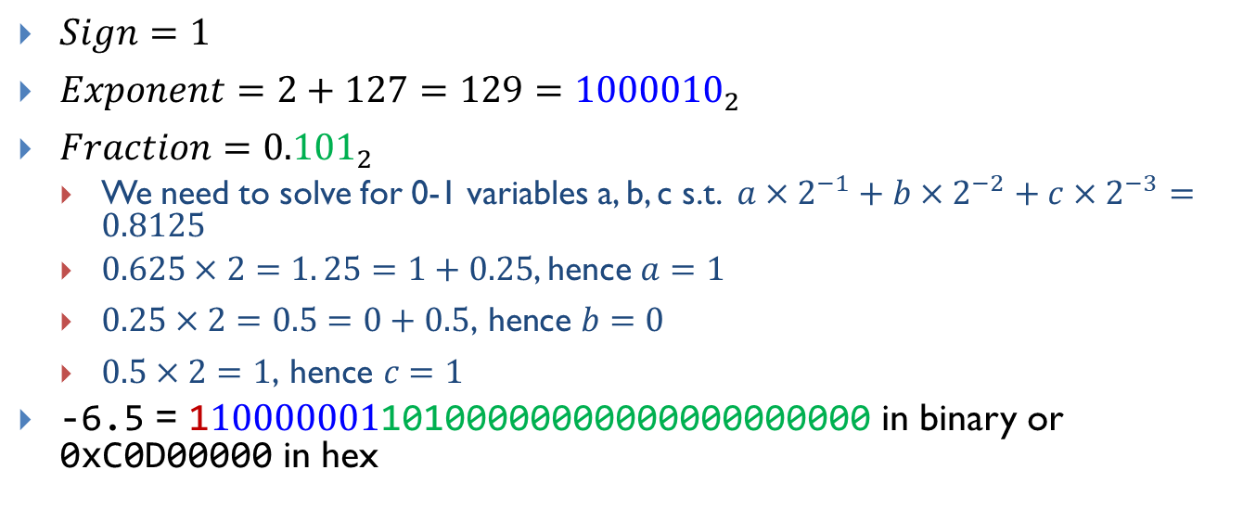

Encoding -6.5 into IEEE Std 754 Single-Precision
Normalization (-6.5 is between 2²=4 and 2³=8, hence we factor out
2²):
$$−6.5=−1.625×2^{2}$$
$$=−(1+0.625)×2^{2}$$
$Sign=1$
$Exponent=2+127=129={1000010}_{2}$
$Fraction={0.101}_{2}$
We need to solve for 0-1 variables a, b, c s.t. ${a×2}^{−1}+{b×2}^{−2}+{c×2}^{−3}=0.8125$
$0.625×2=1. 25=1+0.25$, hence $a=1$
$0.25×2=0.5=0+0.5\text{, }\text{hence} b=0$
$0.5×2=1\text{, }\text{hence} c=1$
-6.5 = 11000000110100000000000000000000 in binary or 0xC0D00000 in hex

Slide 4
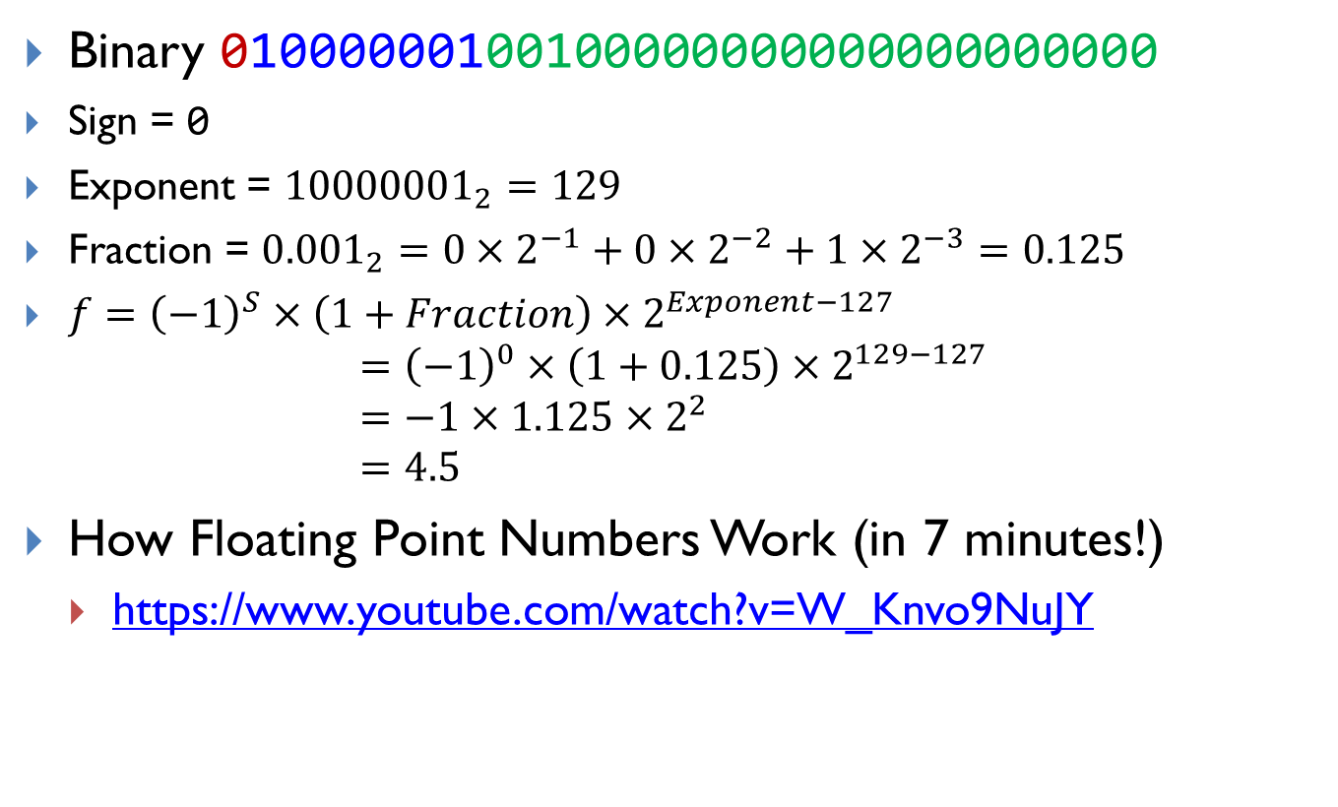
Decoding
Binary 01000000100100000000000000000000
Sign = 0
Exponent = ${10000001}_{2}=129$
Fraction = ${0.001}_{2}=0×2^{−1}+0×2^{−2}+1×2^{−3}=0.125$
$f={\left(−1\right)}^{S}×\left(1+Fraction\right)×2^{Exponent−127}$
$$={\left(−1\right)}^{0}×\left(1+0.125\right)×2^{129−127} \\ =−1×1.125×2^{2} \\ =4.5$$
How Floating Point Numbers Work (in 7 minutes!)
https://www.youtube.com/watch?v=W_Knvo9NuJY

